Slide 1
Aircraft Linked System

Slide 2
Fuel System
by JIA Baohui
中国民航大学 航空工程学院
贾宝惠
24092408;13752593611
jiabaohui@sina.com
Feb,2012

Slide 3
TOPICS
FUNCTION
FUEL STORAGE
PRESSURE FUELING
FUEL FEED
DEFUEL
FUEL INDICATING

Slide 4
FUNCTION
Fuel systems perform the following functions:
- Fuel storage eg fuel carried in integral or removable tanks;
- Supply fuel to engines at flow-rate and pressure required;
- Indicate fuel system data to the flight / ground crew as required, eg Individual fuel tank quantity and total fuel on board (FOB);
- Control and monitor fuel transfer between tanks, (often to regulate the center of gravity of the aircraft and optimize for wing bending relief);
Refuel and defuel;
Jettison;
- Temperature measurement and indication;
- Detecting, indicating and recording of failures.

Slide 5
FUEL STORAGE
These tanks store fuel:
- Main tank 1
- Main tank 2
- Center tank.
The surge tanks collect fuel overflow.

Slide 6
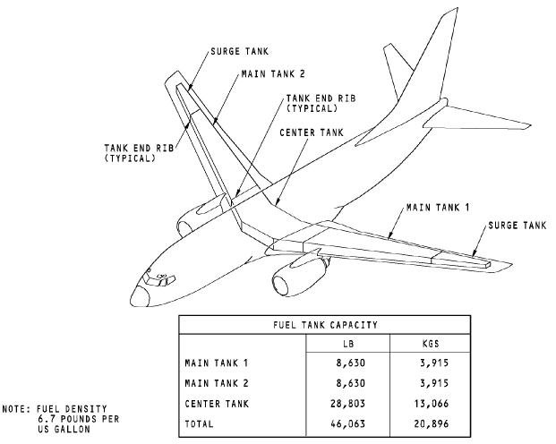
FUEL STORAGE
B737

Slide 7
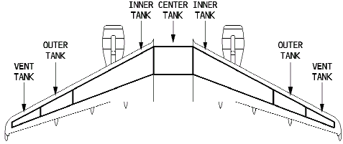
FUEL STORAGE
A320

Slide 8
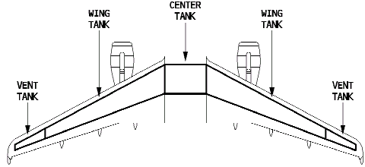
FUEL STORAGE
A321

Slide 9
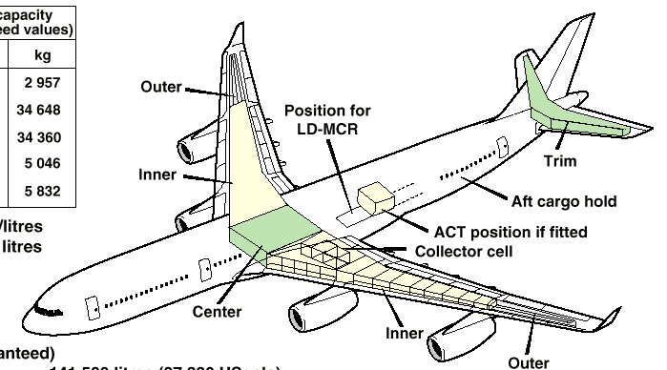
FUEL STORAGE
A340

Slide 10
FUEL STORAGE
Fuel Vent System:
The fuel vent system keeps the pressure of the fuel tanks near the ambient pressure. Too large a pressure difference can cause damage to the wing structure.
Flame arrestors make sure excessive heat does not enter the fuel vent system. A clogged flame arrestor causes the pressure relief valve in the surge tank to open. When open, the pressure relief valve becomes another vent for the fuel vent system.
The fuel vent float valves equalize the pressure between wing tanks and the surge tanks when the airplane is in a cruise or descent attitude.
The drain float valves in the vent tubes and the vent channels permit fuel in the vent system to drain into the tank when the fuel level is lower than the valve.
The surge tank drain check valve permits fuel in the surge tank to flow to wing tanks and also prevents fuel flow from wing tanks to the surge tanks.

Slide 11
FUEL STORAGE
Fuel Vent System:
The pressure relief valve prevents damage to the wing structure when there is too much positive or negative pressure in the fuel tanks. The pressure relief valve is usually closed. When closed, it is even with the bottom surface of the
wing. When there is too much positive or negative pressure, the pressure relief valve opens. When it is open, part of the pressure relief valve is in the fuel tank. After it opens, the pressure relief valve stays in the open position. In the open position, the pressure relief valve supplies an additional vent in the surge tank.

Slide 12
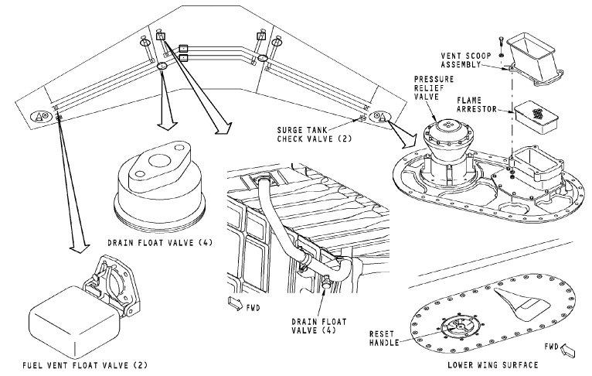
FUEL STORAGE

Slide 13
PRESSURE FUELING
The pressure refueling system fuels each fuel tank.
You also use the system during fuel transfer from tank to tank.

Slide 14
PRESSURE FUELING
The fueling manifold body supplies fuel from the fueling receptacle to the fueling shutoff valves.
The fueling valves control fuel flow to the fuel tanks. A solenoid controls the valve while fuel pressure operates the valve. A manual override plunger on each valve permits manual operation.
The fueling check valves permit fueling receptacle manifold replacement without the removal of fuel from each tank.
The fueling float switches prevent over-fueling the fuel tanks. The fueling float switches remove power to the fueling valves when the fuel level in the tank is full.
The fueling float switches have a float that is in a cylindrical container. When the tank is less than full, the float switch lets power go to the fueling valve solenoid. When the tank gets full, the fueling float switch removes power to the fueling valve solenoid.

Slide 15
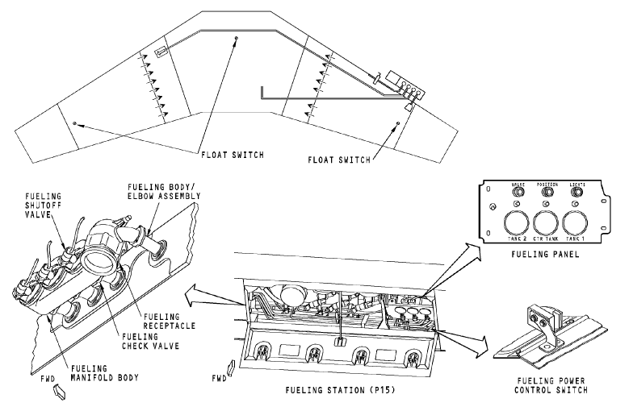
PRESSURE FUELING

Slide 16
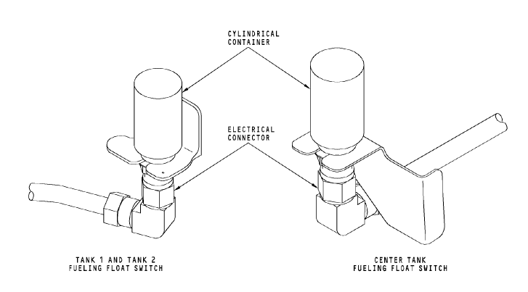
PRESSURE FUELING

Slide 17
FUEL FEED
The fuel feed system supplies fuel from the fuel tanks to the engines and the APU. The fuel control panel controls fuel feed.
The engines use fuel from the center tank before the main tanks. Because of the center tank boost pumps supply fuel at a higher pressure than the pumps in the main tanks, the fuel in the center tank is used before the fuel in the main tanks.
The APU usually receives fuel from main tank 1. However, with use of the fuel boost pump switches, any fuel tank can supply fuel to the APU.

Slide 18
FUEL FEED
The engine fuel spar valves control fuel flow to the engines. The engine start levers and the engine fire switches control the engine fuel spar valves.
The crossfeed valve permits a single fuel tank to supply fuel to both engines.
A bypass valve supplies a secondary fuel flow path to the engines. The bypass valves operate automatically.
The APU fuel shutoff valve lets fuel flow from the left engine fuel feed manifold to the APU.

Slide 19
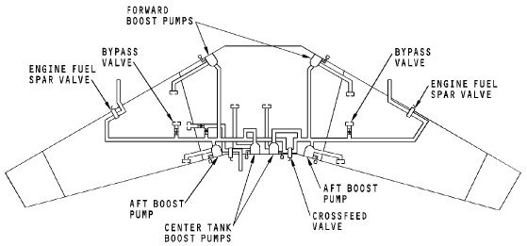
FUEL FEED

Slide 20
DEFUEL
The defuel system permits the removal of fuel from each tank to the refuel station. It also permits the transfer of fuel between tanks on the ground.

Slide 21
Jettison:
Rapid means of weight reduction:
  To achieve MLW. (max landing weight.)
  To ensure altitude can be maintained above mountains in case of engine failure.
  To reduce weight and fuel quantity to minimum in emergencies.
Jettison shutoff occurs:
  When low low fuel quantity signal is received.
  When aircraft gross weight reaches.
  Dedicated jettison pumps run dry.

Slide 22
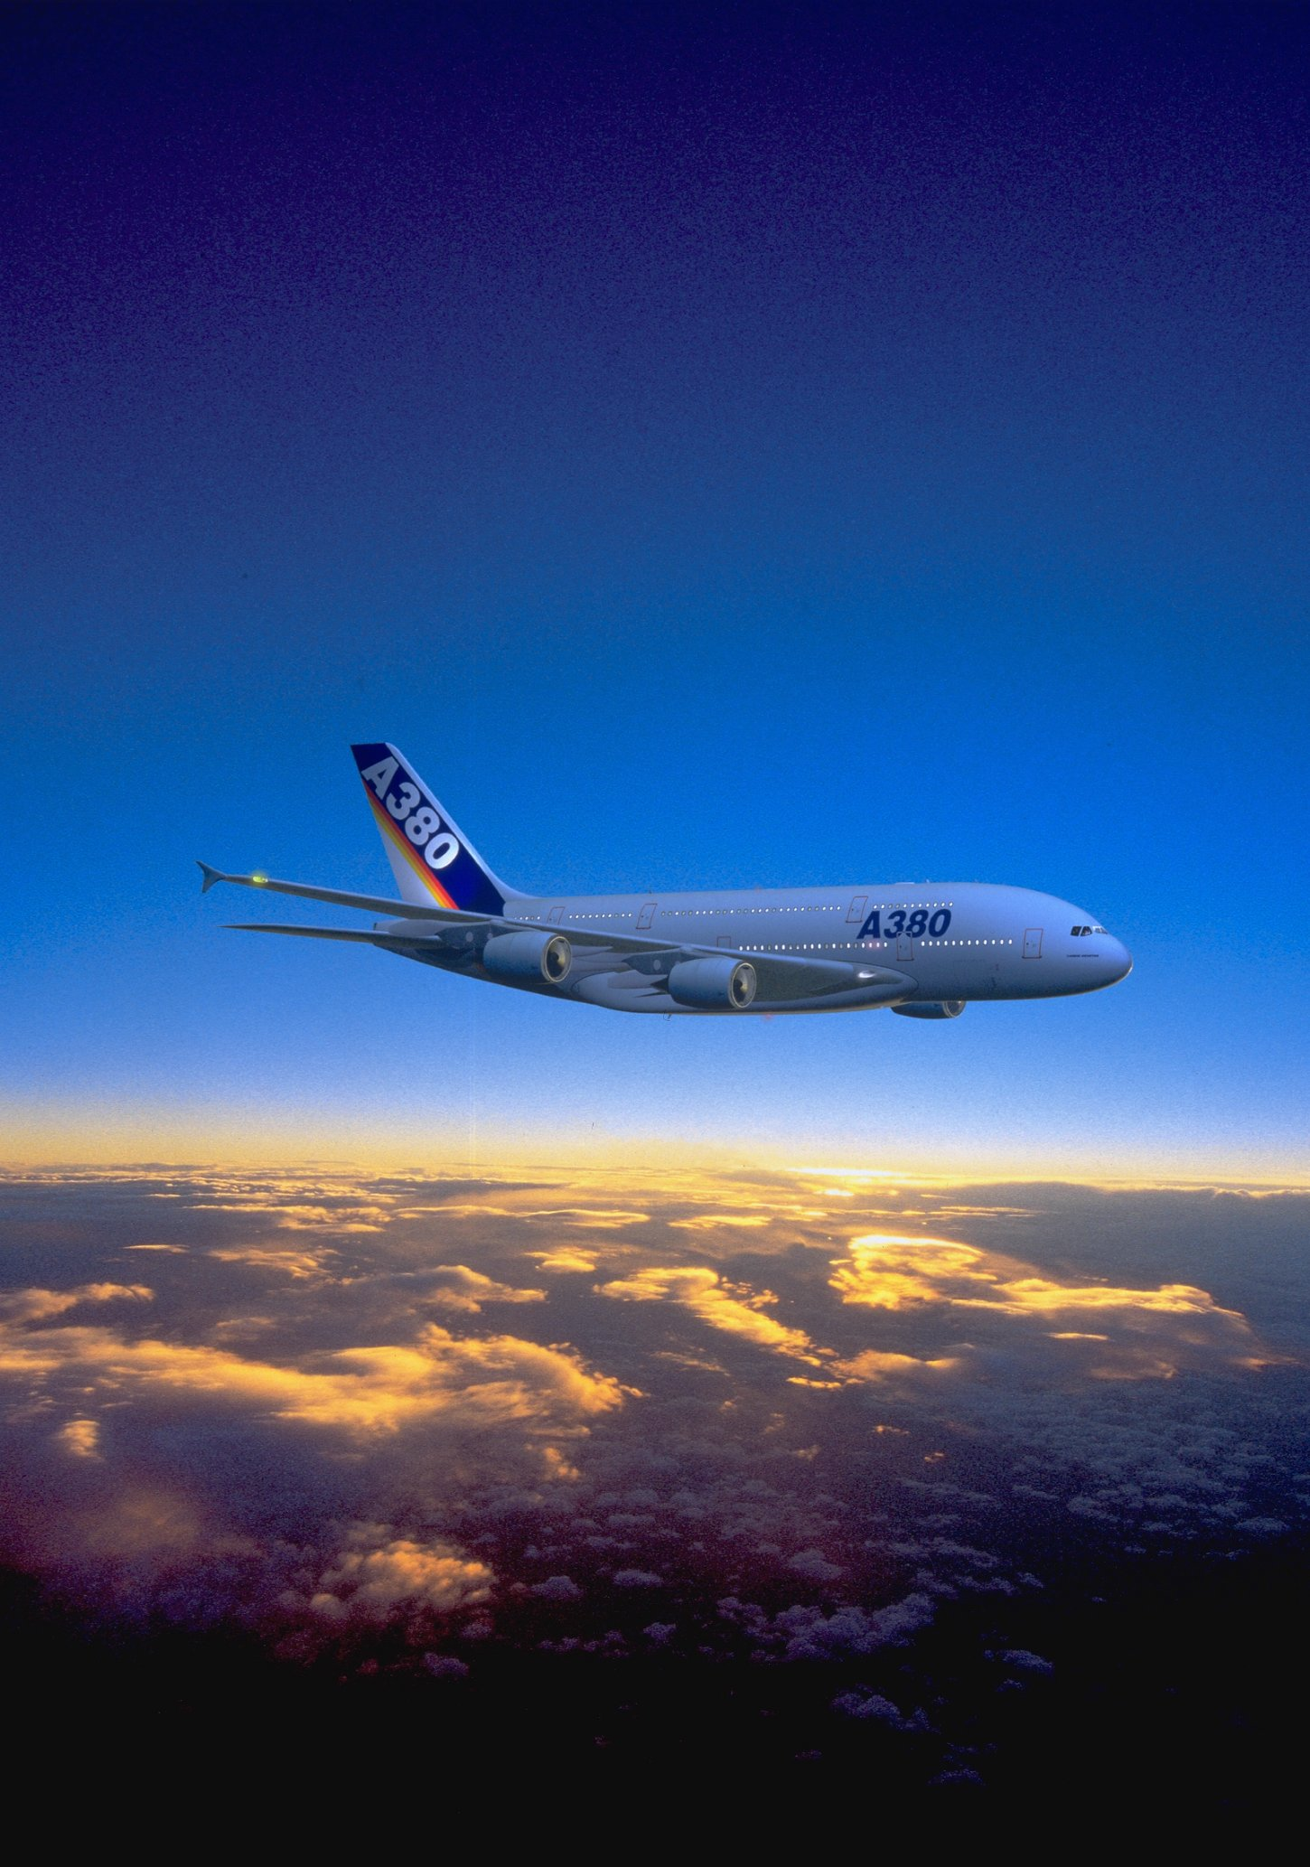

Slide 23
FUEL INDICATING
The fuel quantity indicating system (FQIS) shows fuel weight of the tanks.

Slide 24
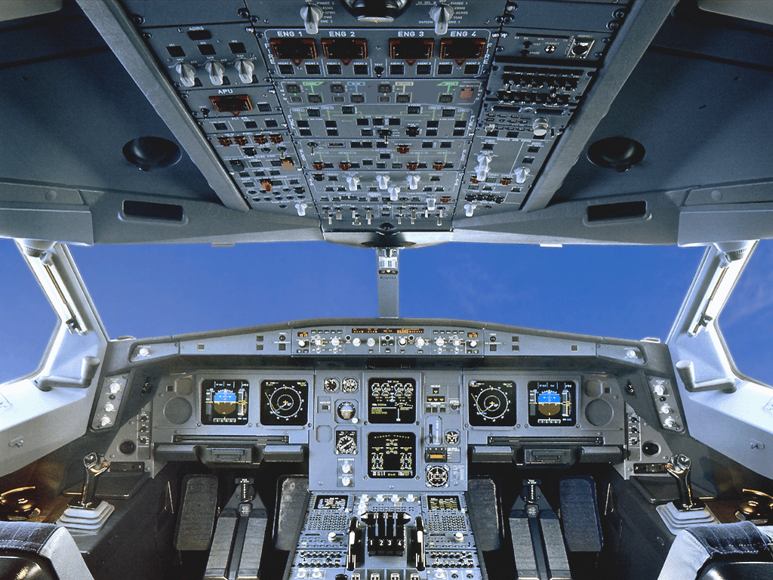
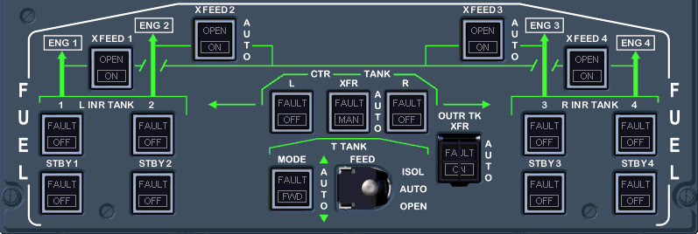
7) Pilot Presentation.

Slide 25
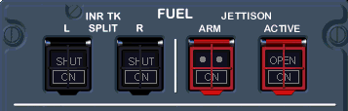
7) Pilot Presentation.

Slide 26
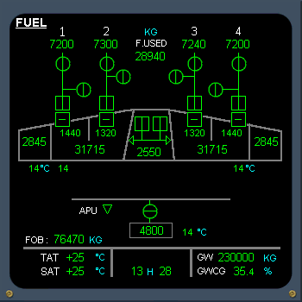
7) Pilot Presentation.

Slide 28
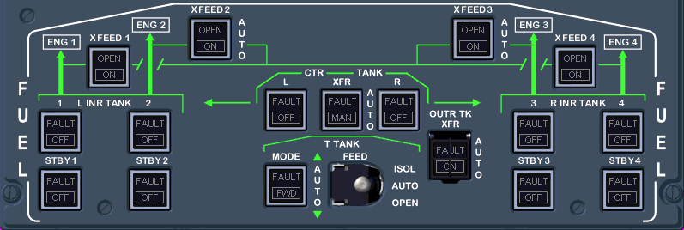
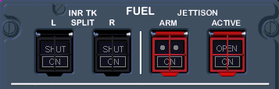
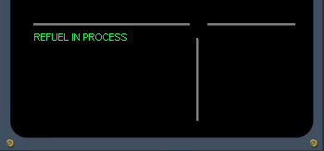

Slide 29

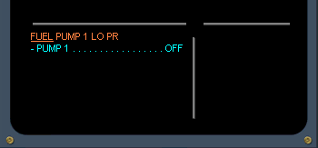
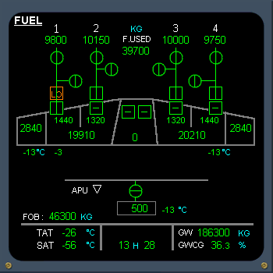

On the E/WD, read the title of the failure.
ECAM FUEL page is automatically displayed.
Pump is indicated LO on ECAM
FAULT is illuminated on overhead panel
Perform ECAM action.

Slide 30

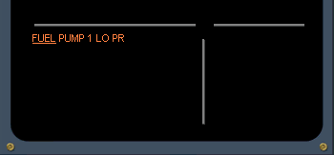
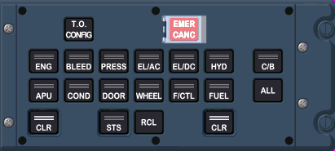
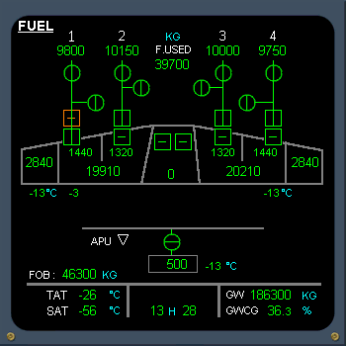
LO replaced by amber cross line.
After review and confirmation from the PF...
Clear FUEL.

Slide 31
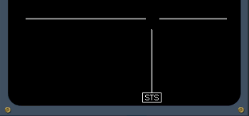
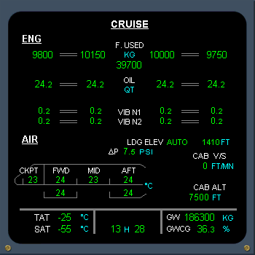
7) Pilot Presentation.
ECAM action completed.

Slide 32

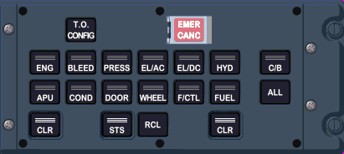
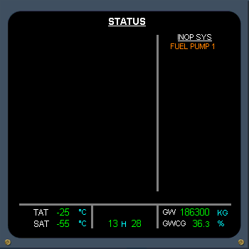
On the STATUS page, FUEL PUMP 1 appears amber in the inoperative system column.
After review and confirmation from the PF...
Clear STATUS.

Slide 33
Fuel Specifications.
Characteristics
  Dielectric constant/permittivity.
  Freezing point/max temp.
  Conductivity.
Additives
  Anti-icing.
  Anti-static.

